Slide 1
Hospitality Analysis
File created on: 11/22/2022 3:47:03 PM

Slide 2
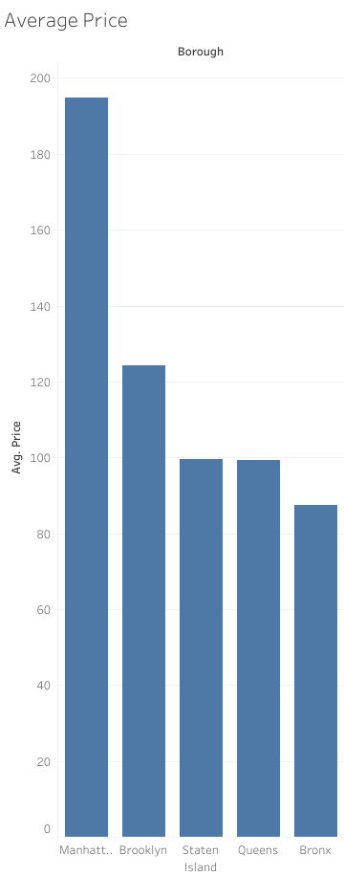

Slide 3
